Slide 1

Welcome to St James CE Primary School!

Slide 2
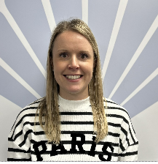
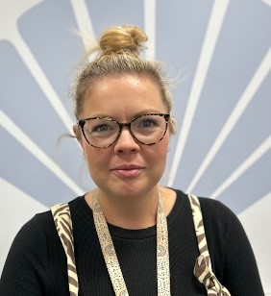
Meet the team!
Reception Class Teachers
Mrs Hatcher and Miss Price
Monday, Tuesday, Wednesday Thursday, Friday

Slide 3
We are here today to share more information about your child’s transition to school and there will be plenty of time at the end for us to answer any of your questions.

Slide 4
What are the areas of the Early Years Foundation Stage?
In Reception we teach 7 key learning areas.
3 Prime Areas and 4 Specific Areas.
  Communication and Language
  Personal, Social and Emotional Development – self regulation, managing self, building relationships
  Physical Development- gross and fine motor
  Literacy
  Mathematics
  Understanding the World – (Science, RE, History, Geography)
  Expressive Arts and Design
  We use a mixture of child initiated play and adult guided tasks throughout the day to ensure your child covers all of the learning areas through our well planned curriculum.

Slide 5

The School Day
School starts at 8.45am
It is very important that you are on time in the morning.
The register will shut at 9.00am
We have lunch at 11.45-1.00pm
School finishes at 3.20pm - please collect your child from the Reception gate.

Slide 6
The Inkpen Day
8.45-9.00 Morning challenge
9.00-9.30 Phonics session (Little wandle)
9.30-9.45 Snack and a story
9.45-11.00 Independent learning and group work
11.00-11.30 Singing and handwriting session
11.45-1.00 Lunch
1.00-1.20 Topic/ maths fluency
1.20-2.30 Independent learning and group work
2.30-3.00 Milk/ story time/Collective worship
3.20 News/ Home time

Slide 7



What do I need for school?
A Book Bag.
Literacy packs will be given to you by the school and should be kept inside your child’s book bag. This will include your child’s reading book. Letters will also be put into your child’s book bag when needed.
A Water Bottle.
Please send your child to school with a named water bottle each day. These will be sent home at the end of each day to be re-filled.
Wellington Boots.
Please send your child to school with a named pair of wellington boots. These will need to be kept at school, as they will need them daily to access our outdoor spaces!

Slide 8
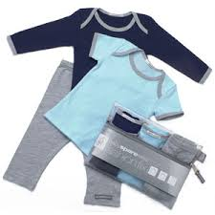
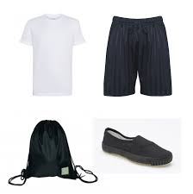
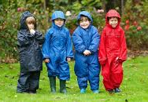
What do I need for school?
Spare Clothes.
The children each need a bag of spare clothes which they keep on their pegs at school. We suggest a few pairs of underwear and socks, spare trousers/ leggings and a top. Please name everything!
PE Kit.
This is worn to school on PE day. Inkpen class have PE on a Wednesday morning. Your child will need navy or black shorts and a plain white T-shirt or polo shirt.
Weather-appropriate clothing.
We have a weekly forest school session and at lunch time we are very lucky to have a brilliant outdoor space, so please ensure your child has waterproofs at school (a light waterproof for the Summer and warm clothes for the Winter).

Slide 9
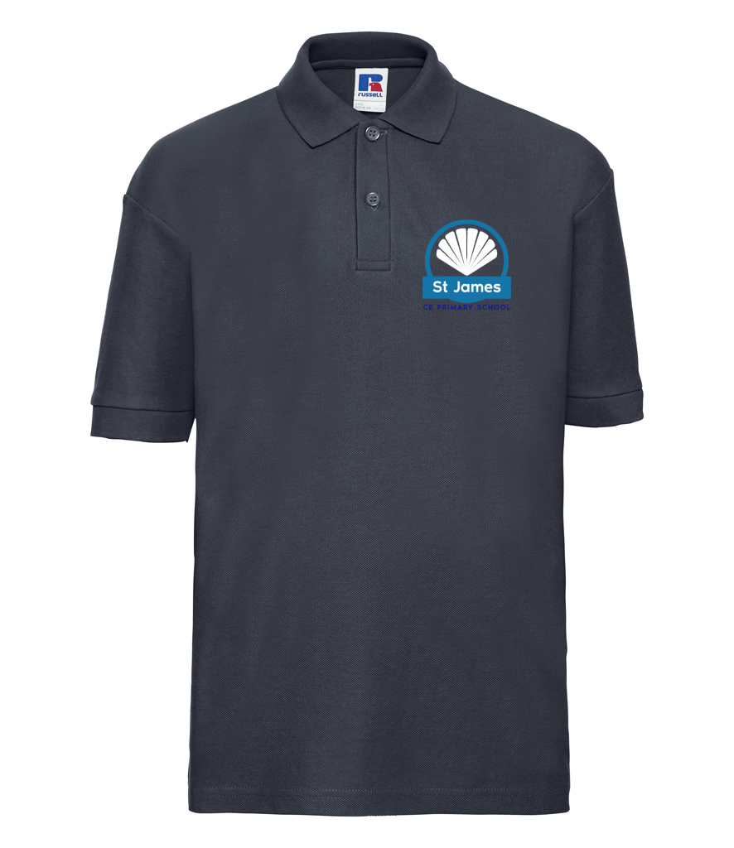
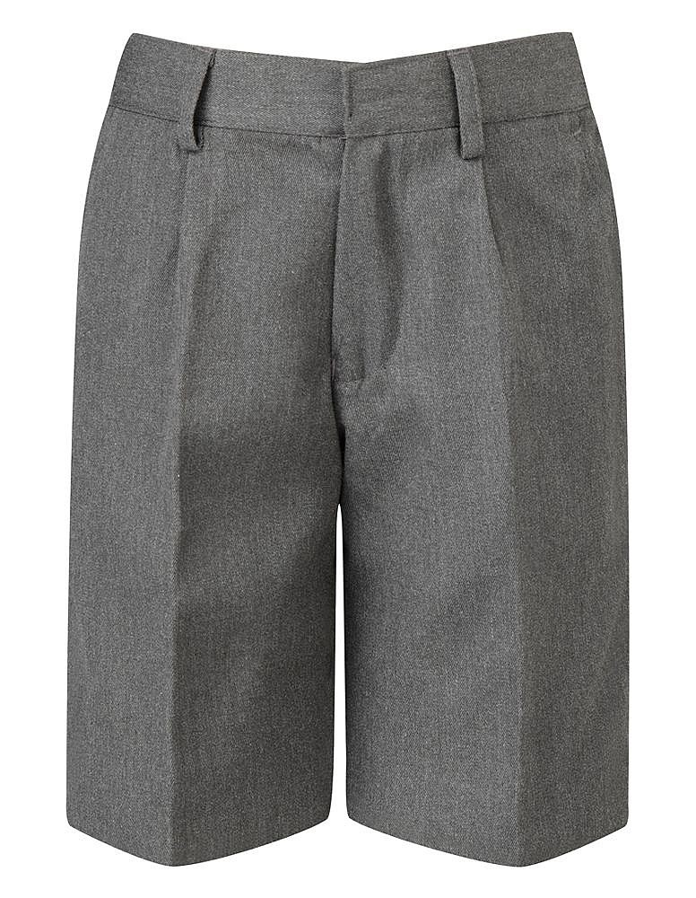

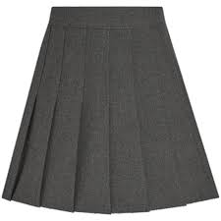


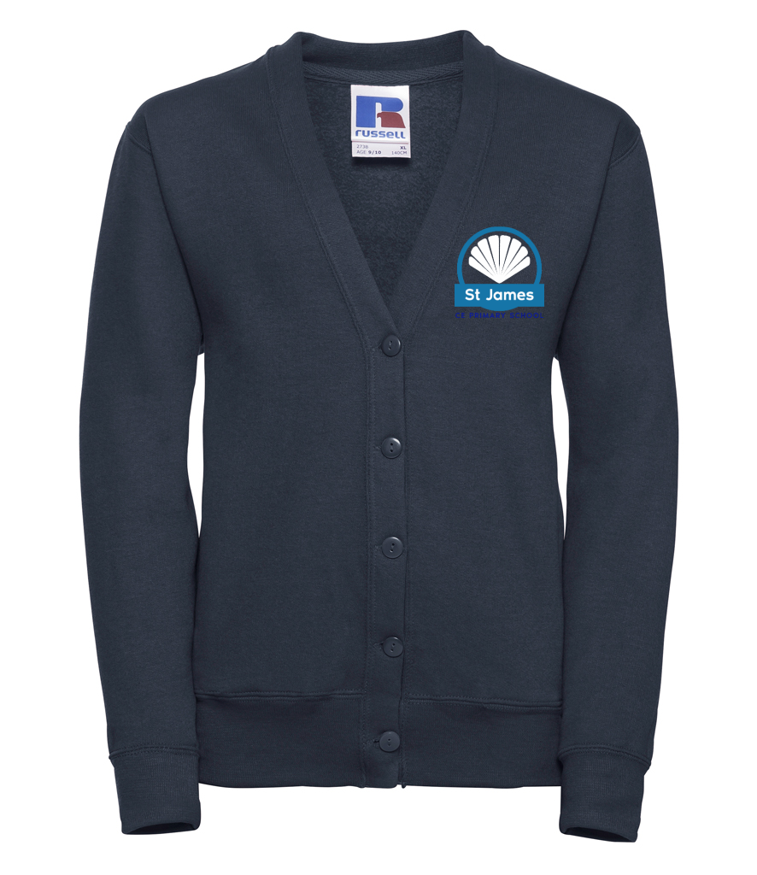
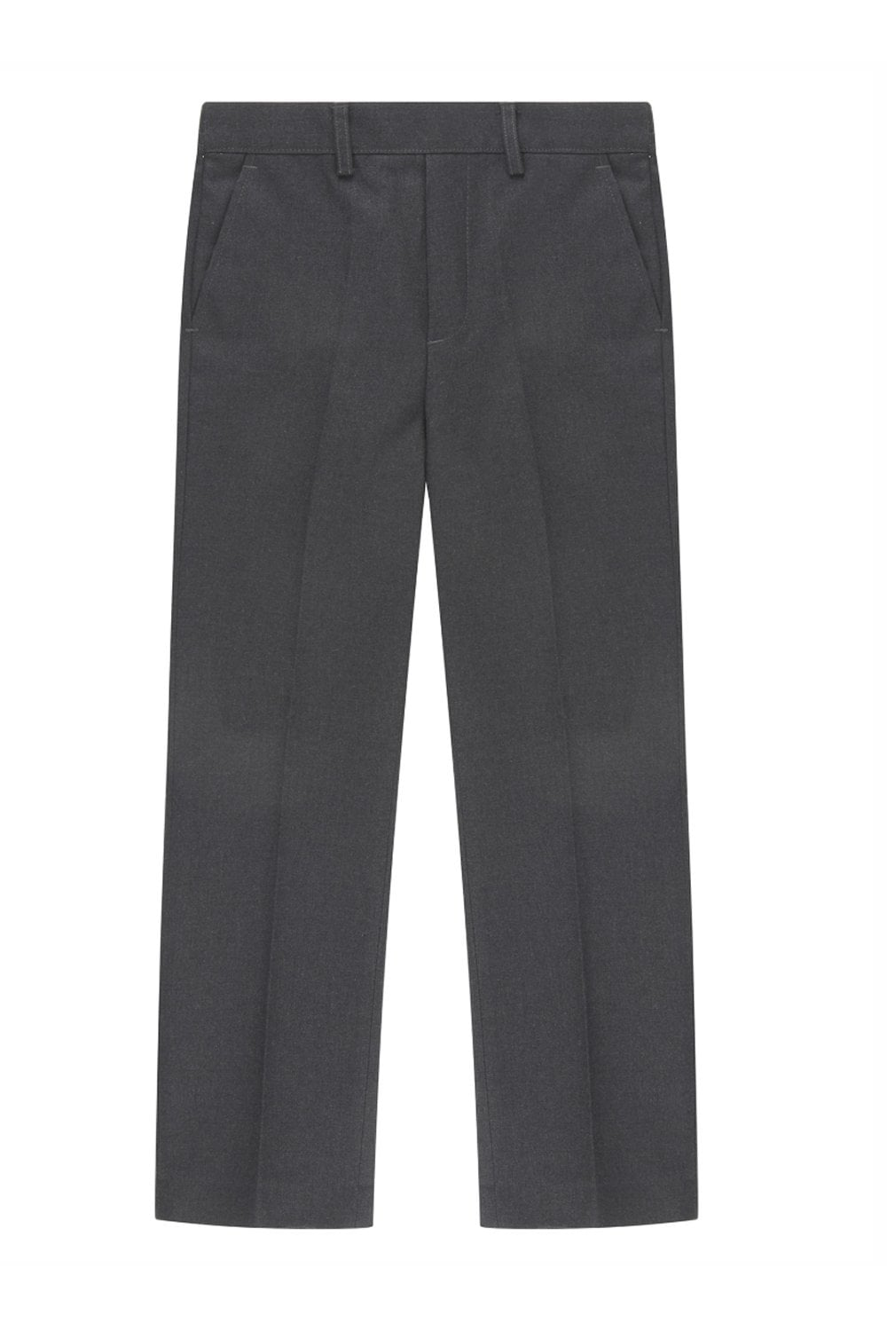
School Uniform
HOW TO ORDER:
We have a new uniform provider- PMG in Farigdon - All the information that you need is in your paper packs

Slide 10
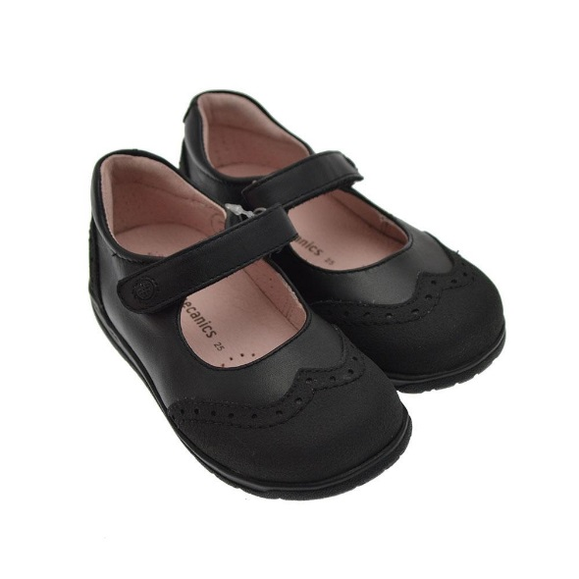
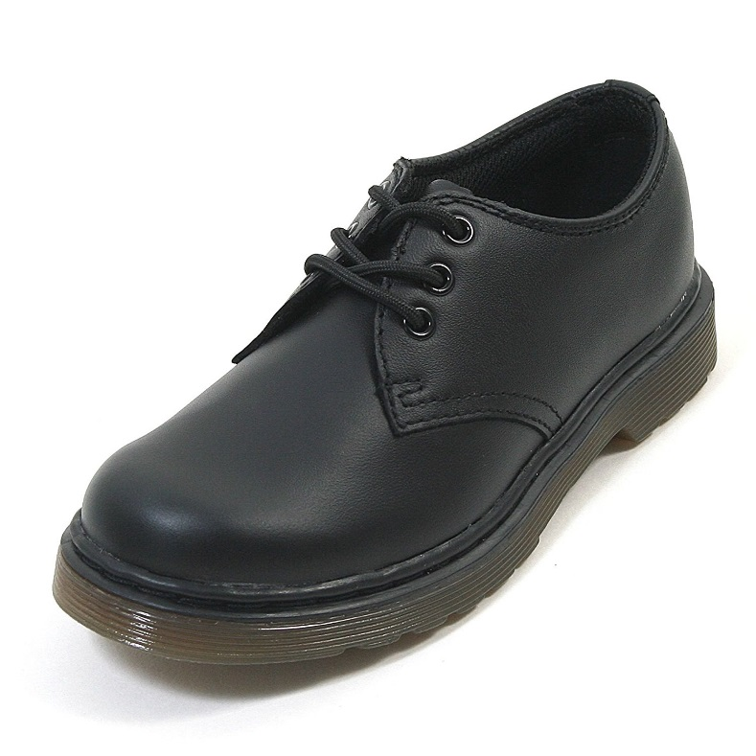
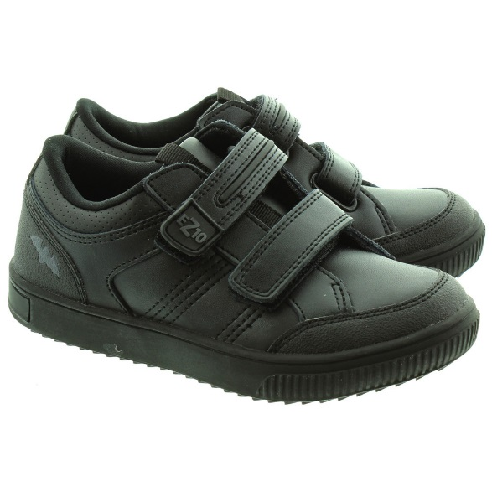
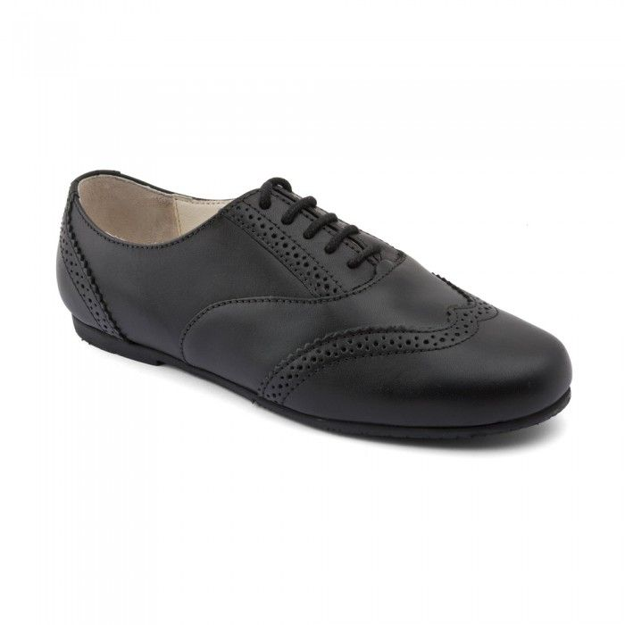
Please, no shoes with laces until your child is able to tie them independently.
🗶
✔

Slide 11


Milk and Fruit
In Reception, your child will receive a piece of fresh fruit for their snack and a carton of milk each day.
Notes:
Add in about

Slide 12
School dinners:
Children receive free school dinners until the end of Year 2.
The school dinners must be ordered at least two weeks in advance using Parent Mail.
You can also book for the whole school term which is what most parents do.
If you would prefer to make a packed lunch for your child, then please ensure it is a healthy packed lunch and nut free. This includes nut chocolate spreads and cereal bars with nuts.

Slide 13
Wrap around care…
Breakfast Club
Sessions start: 7.30am until School Start
Fees per session: 7.30am until 8:45am = £6.00 (includes breakfast)
Afterschool Club
Sessions start: School end until 6.00pm
Fees per session: 3.20pm – 6.00pm = £12.00 (includes hot tea)
If you would like to get in touch with the club, please contact us:
Tel: 07770166157
Email: theclub@stjamesce.vale-academy.org
Mrs Green- Book your sessions through your Parentmail account. (These will be set up ready for your September start).

Slide 14

-Photographs about our learning
-Half termly overviews about our topics and curriculum
-Messages to parents regarding any information you need to know
-Individual profiles
We love to see the learning your child does at home too!
How will we keep you updated?

Slide 15
Paperwork
Please take your paper packs home to complete then return to school ASAP.

Slide 16

IMPORTANT DATE!
Transition Morning is: Thursday 10th July 9.30- 11.
You are welcome to come to school for a stay and play session with your child.
Please see paper packs for your child’s September start date.
(Phased start of term)

Slide 17


Exciting opportunity
Lisa Knight from Abingdon and Whitney College will be coming in to school to run some family support workshops on Managing feelings and behaviour.
There will be 6 courses running from September so please speak to our SENCO Mrs Potter or our home school link worker Mrs Richardson to book onto this.

Slide 18

Thank you!
We would like to thank you for coming and we will be available to answer any of your questions over a tea and coffee if you would like to stay.
We are very much looking forward to the new school year and we are very excited to be a part of the success and progress your children will make next year.
Thank you all for your time today.

